Slide 1
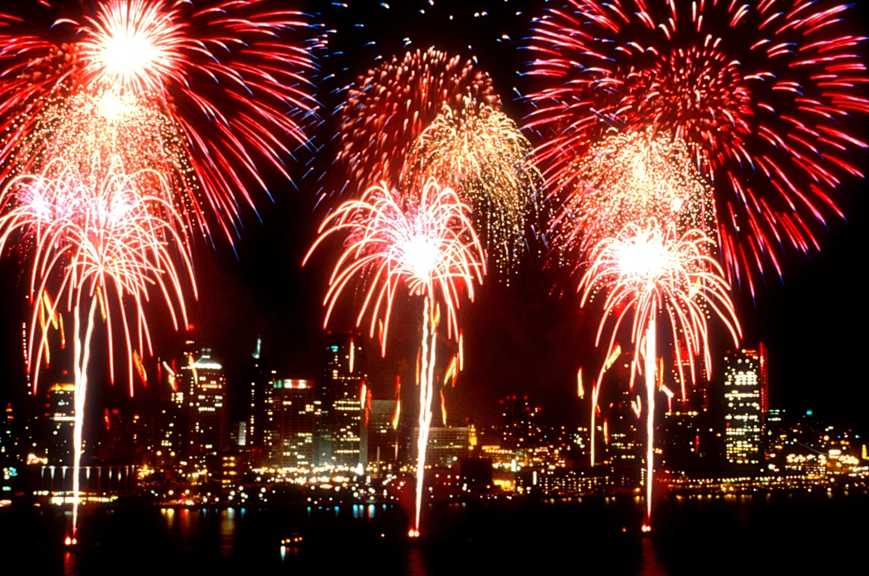
What do you like to do on the 4th of July?

Slide 2
Have you ever had a bad break up?

Slide 4
School House Rock Videos
“No More Kings”
https://www.youtube.com/watch?v=p8BwWBc571k
Fireworks
https://www.youtube.com/watch?v=ZTY0V8GaeFI

Slide 5
Time to tweet

Slide 6
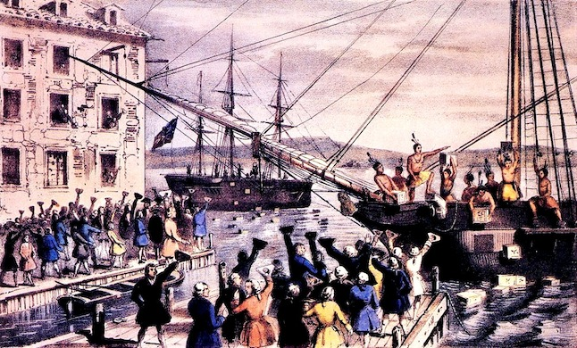

Slide 7
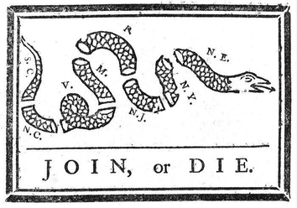

Slide 8
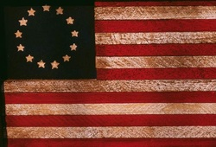

Slide 10
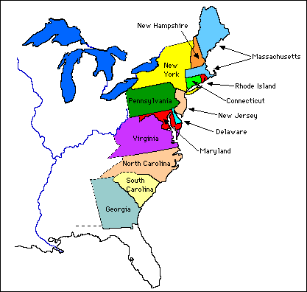

Slide 11
American Revolution

Slide 12
Key Vocabulary
Tax- extra amount of $ paid to the government
Act- Law
Independent

Slide 13
What do you like to do on the 4th of July?

Slide 14
Have you ever had a bad break up?

Slide 15
Stuff we’ve already learned that affect the American Revolution
Exploration/Colonization
Enlightenment ideas influence American Revolution
Ok….let’s look at a little background information

Slide 16
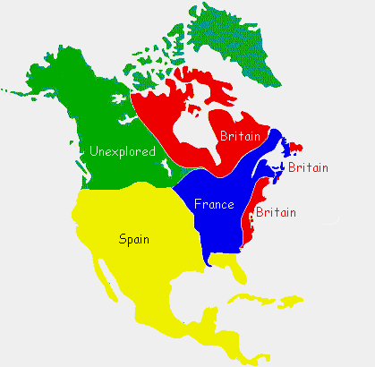
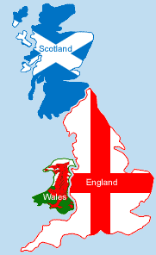
O.k. so here’s the delio….
In the 1600s Great Britain set up colonies on the eastern coast of North America (remember that whole mercantilism/triangular trade thingy…)

Slide 18
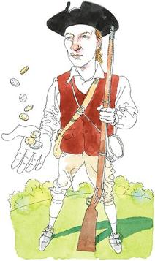
Almost 200 years later most colonists didn’t see themselves as “British”
They saw themselves as almost an “American nation”
Am I British or “American?”

Slide 19
So……what caused the colonists living in the British colonies to finally fight for their independence?
WHAT HAPPENED?
This is where the Road to Revolution begins!

Slide 20
5 W’s of American Revolution

Slide 21
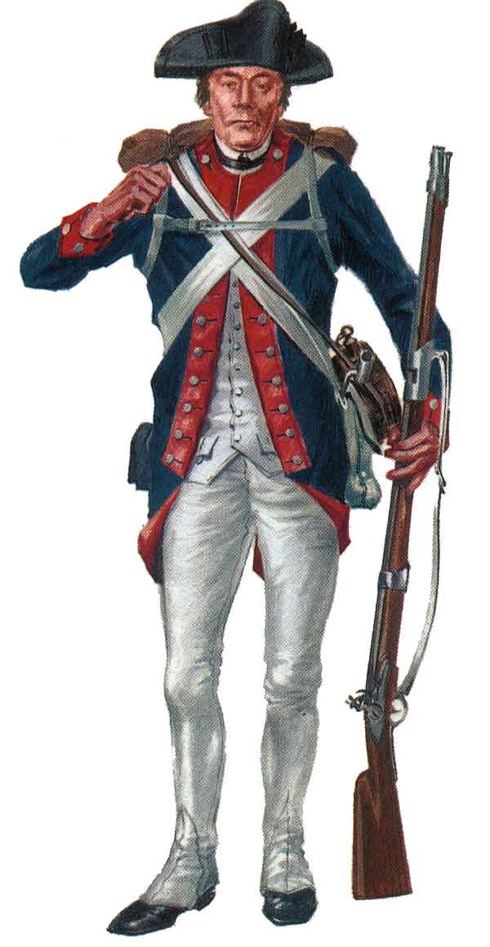
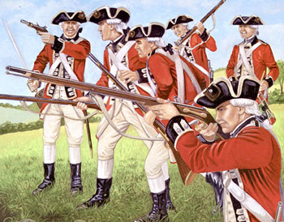
Who fought in the American Revolution?
British vs. Colonists

Slide 22
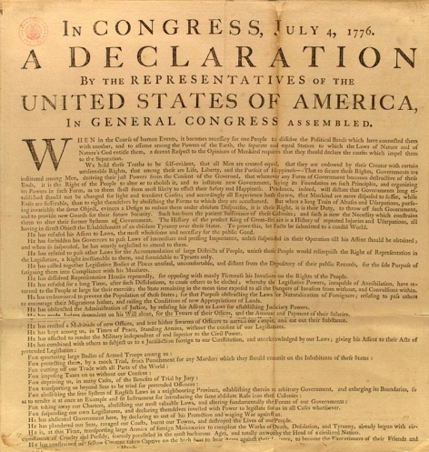
What was the American Revolution
The fight for independence from the British
Declaration of Independence
July 4, 1776

Slide 23
When did it happen?
Tensions began between the colonists and the British after the French and Indian War until the Declaration of Independence 1776

Slide 24
Where did it happen?
North America- British colonies

Slide 25
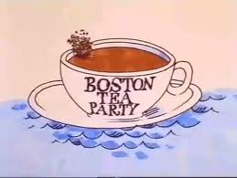
Why did it happen?
“taxation without representation.”
Colonists freedoms taken away by British king
Desire to govern themselves independently
These are the causes!

Slide 26
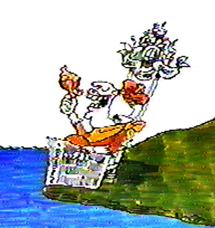
How did the Enlightenment play a role in the American Revolution?
John Locke’s natural rights inspired Thomas Jefferson and the writing of the Declaration of Independence
“life, liberty, and the pursuit of happiness”
Gov’t must protect these rights!!
No more king!

Slide 27
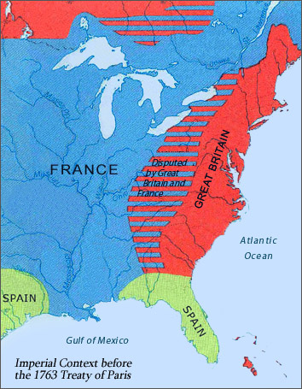
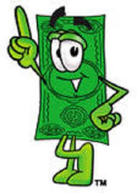
It all begins with the French and Indian War

Slide 28
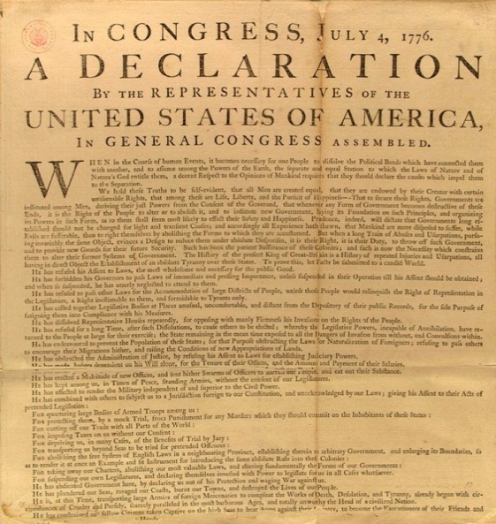
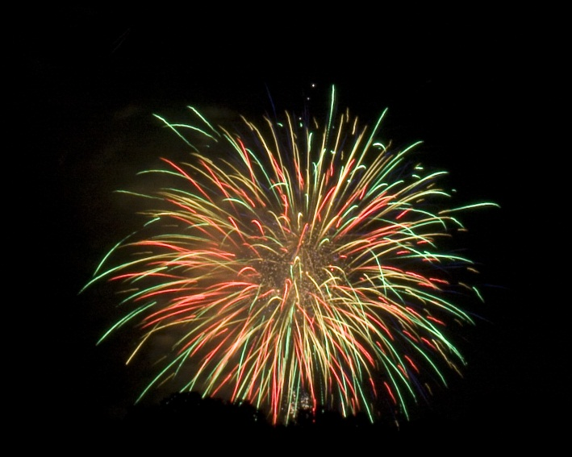
What happens after the French and Indian War?
A series of British actions (mostly taxes) and colonial responses!
Tensions grow between the colonists and the British until finally the colonists declare their independence!

Slide 29
Causes and Effects of the American Revolution
“taxation without representation.”
Colonists freedoms taken away by British king
Desire to govern themselves independently
U.S. Constitution using a federal system (power divided into national and state governments)
Balance of power in gov’t such as checks and balances

Slide 30
ROAD TO REVOLUTION
French and Indian War
Proclamation of 1763
Stamp Act
Tea Act
Boston Tea Party

Slide 31
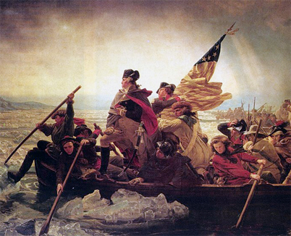
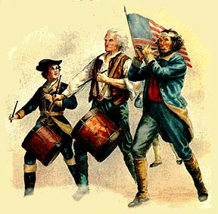
THE WAR IS ON!- HERE COMES THE U.S.!

Slide 32
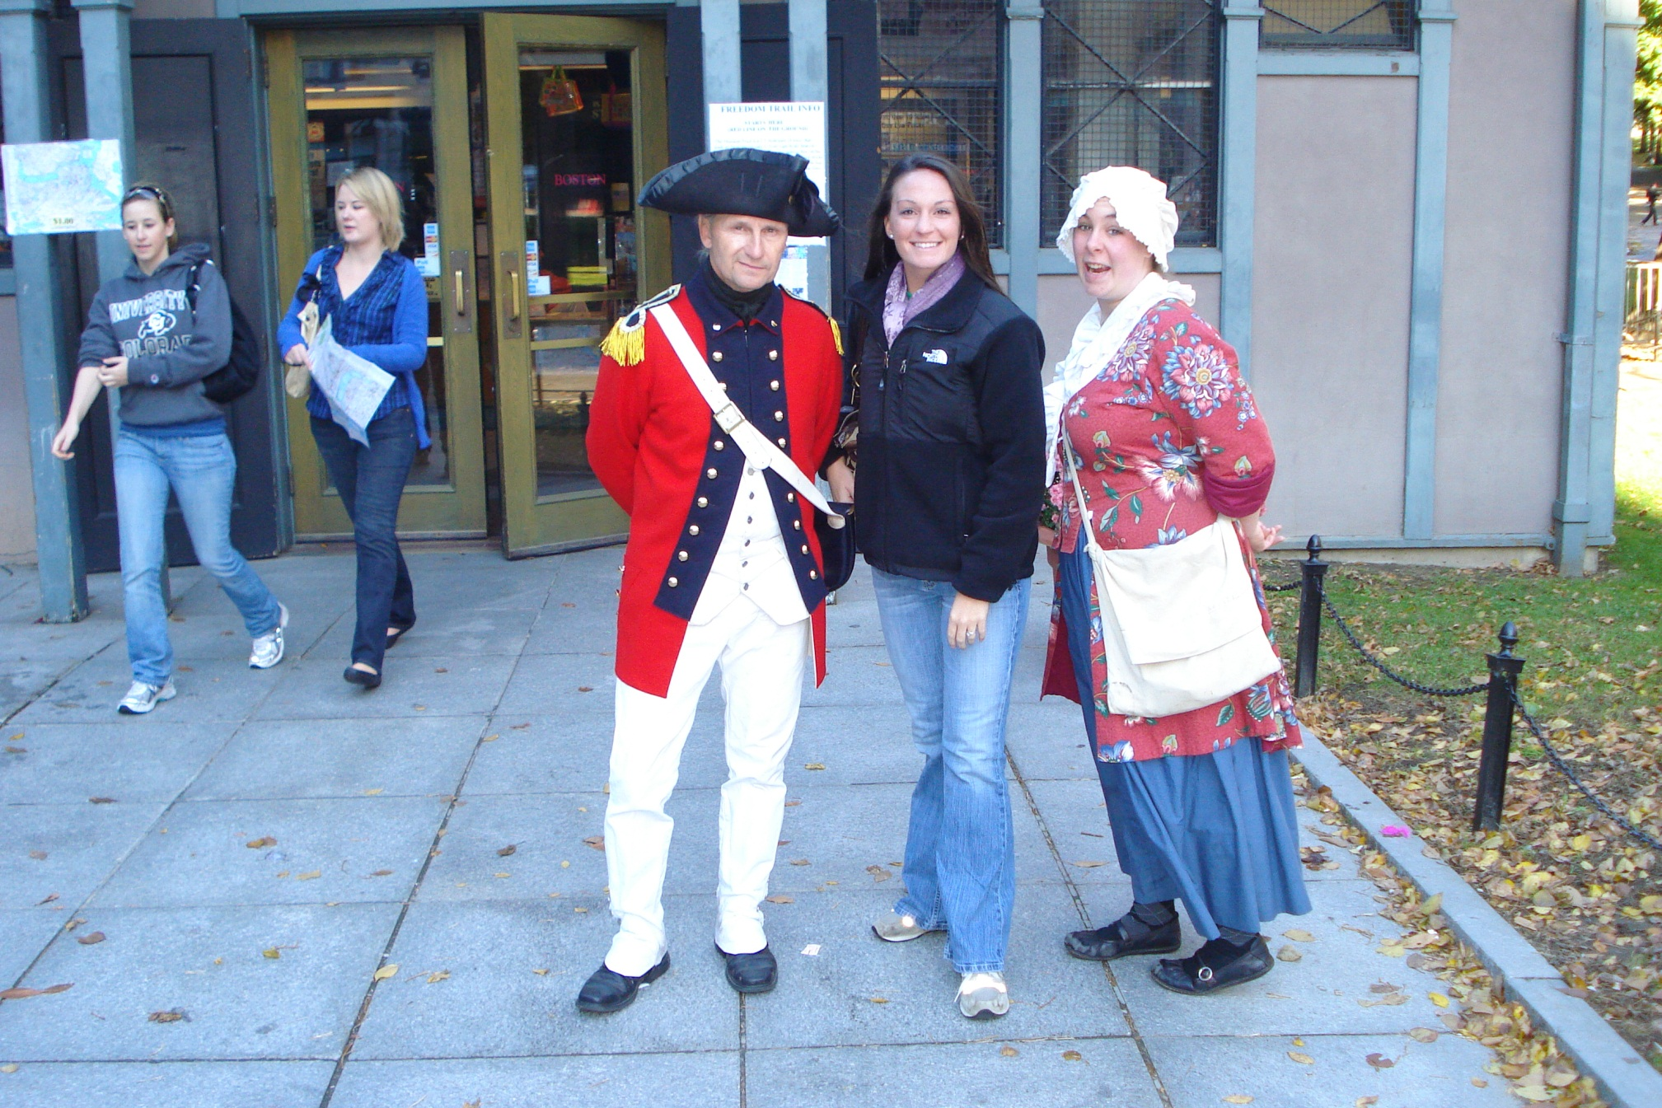

Slide 33
French and Indian War

Slide 34
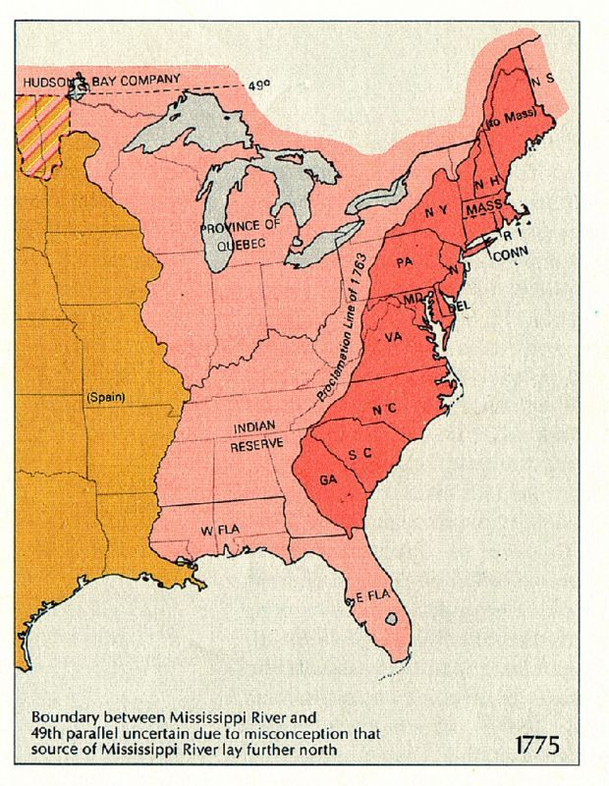
Proclamation of 1763

Slide 35
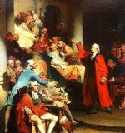
Currency Act of 1764

Slide 36
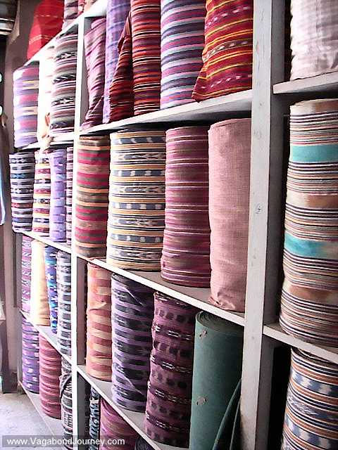
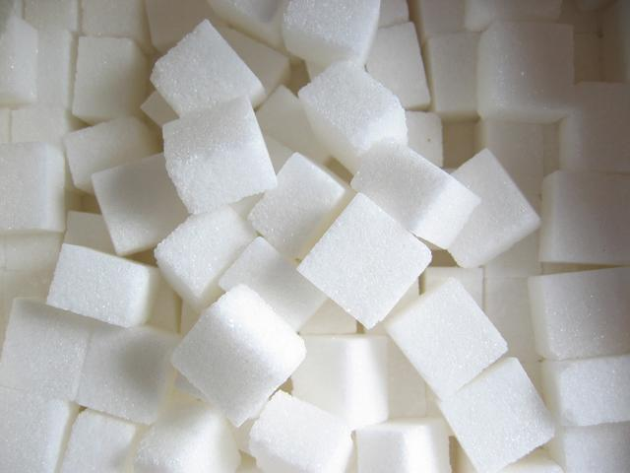
Sugar Act of 1764

Slide 37
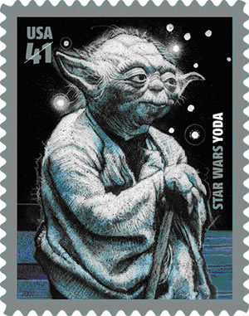
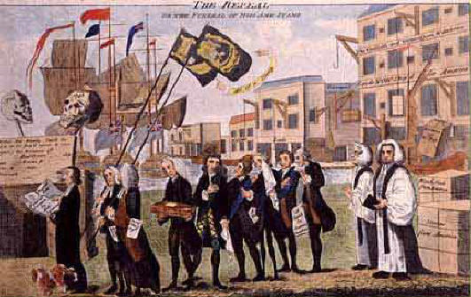
Stamp Act of 1764

Slide 38
Quartering Act of 1765

Slide 39
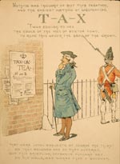
Tea Act 1773

Slide 40
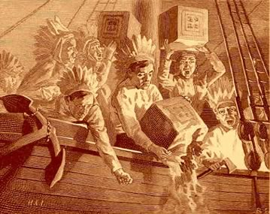
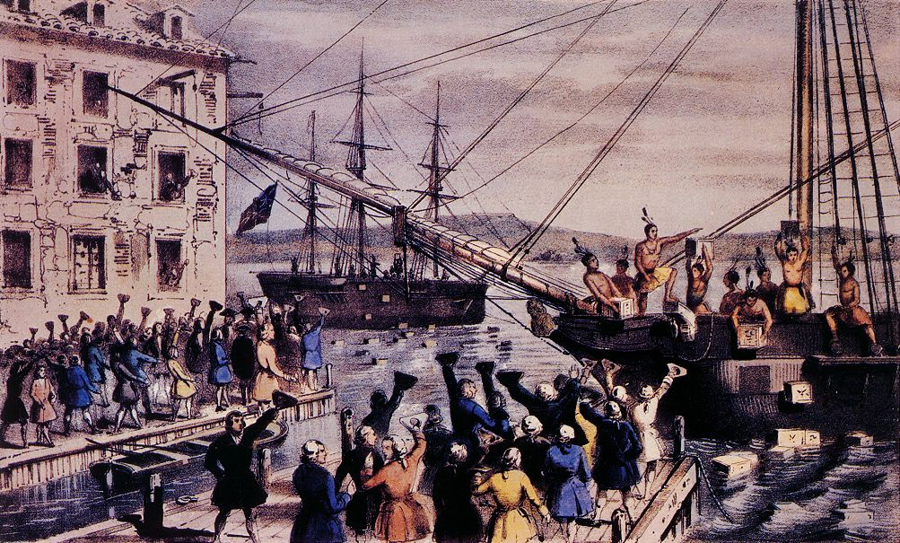
Boston Tea Party 1773

Slide 42
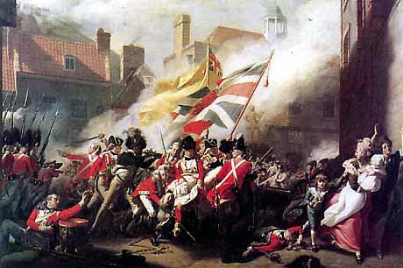
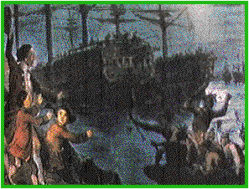
Coercive Acts 1774

Slide 43
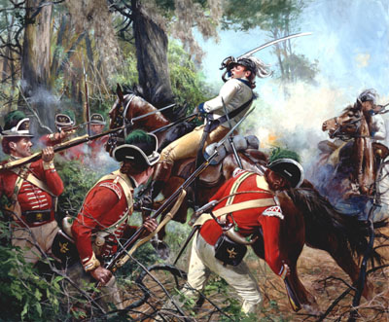
Revolutionary War

Slide 44
