Slide 1
American Revolution guided ppt notes

Slide 2
The American Revolution
George Washington was named Commander in Chief of the Continental Army
reorganized the army, secured additional equipment and supplies, and started a training program to turn inexperienced recruits into a professional military

Slide 3
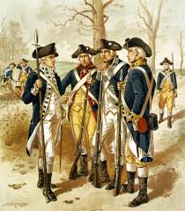
Life in the Continental Army
life was hard
Enlistments lasted from 1-3 years
states differed in how well and how often they paid their soldiers, housed them when they were not on the march, and supplied them with food, clothing, and equipment.
army had stern discipline,
the chances were great for being
wounded or killed, and British victories.
undermined morale

Slide 4
Crossing the Delaware
Christmas Night 1776
victory
turning point for America & the Revolutionary War
As a snowstorm pounded, Washington and his soldiers, crossed the Delaware River to stage a surprise attack on a fort occupied by Hessian mercenaries fighting for the British
Stories say that the Hessians were passed out drunk
This victory proved Washington’s army could fight as well as an experienced European army.

Slide 5
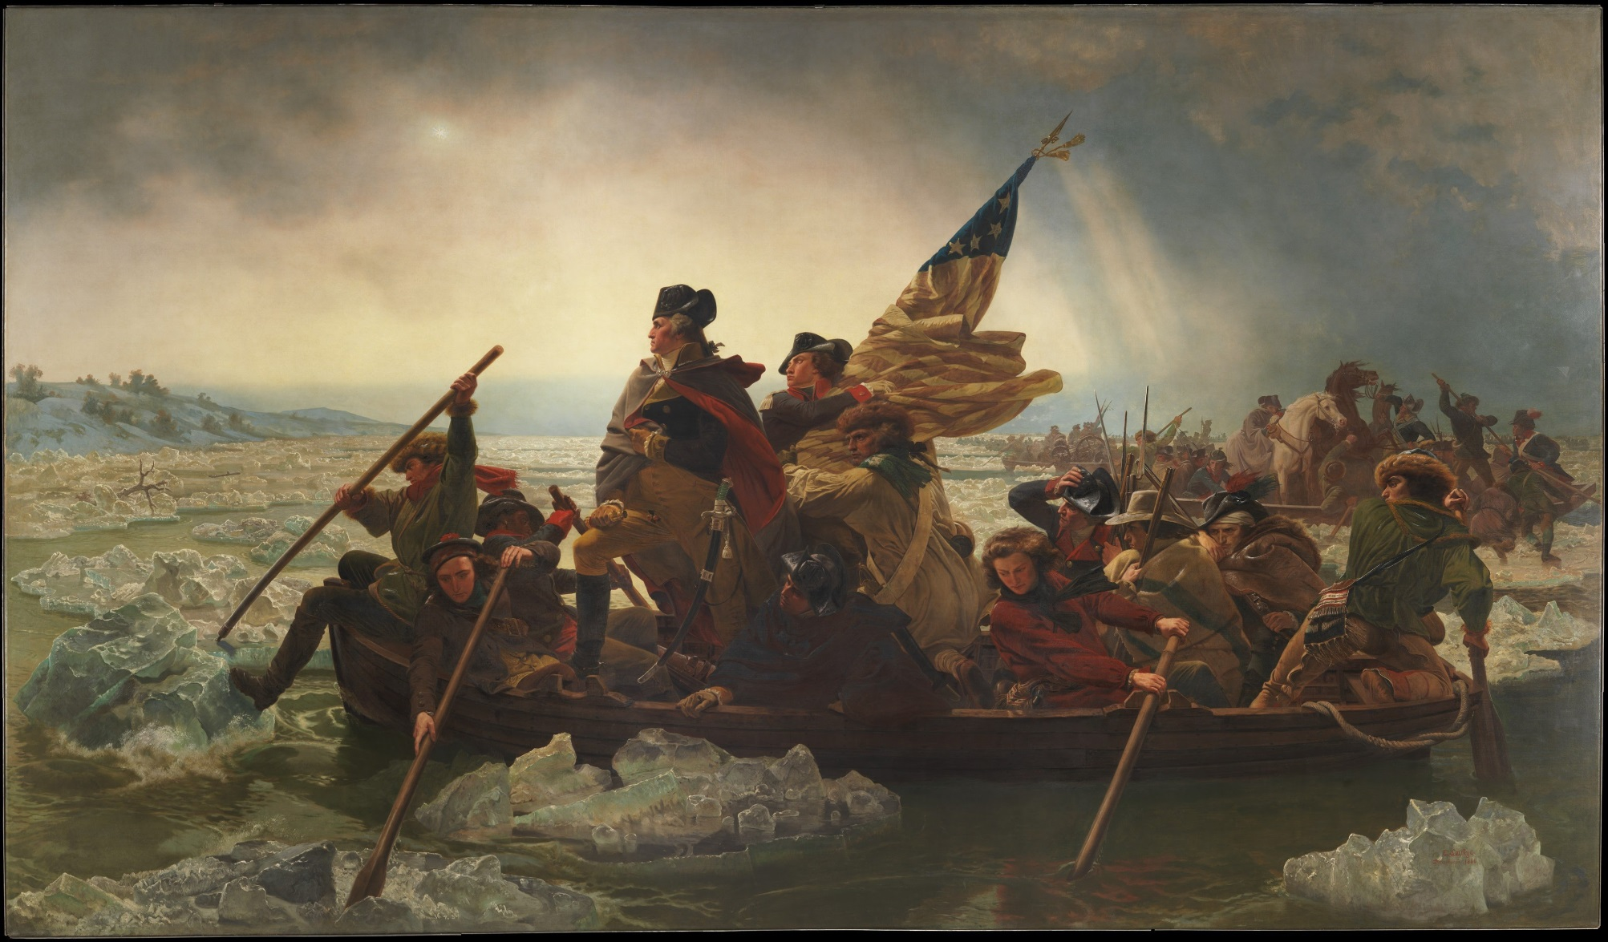

Slide 6
Valley Forge
Washington and his troops spent the winter of 1777–1778 in Valley Forge, Pennsylvania.
spent 6 months there
The army’s problems with wages, housing, food, clothing,
and equipment were at their worst.
Disease spread throughout the camp, increasing the
suffering of the 12,000 men.
As conditions worsened, almost 4,000 soldiers were too
weak or ill to fight.
Yet that winter Washington ordered an intense training program—similar to a modern boot camp—that turned the Continental Army into a capable and
self-assured infantry.

Slide 7
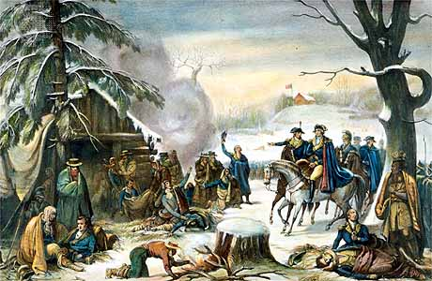

Slide 8
French Alliance
France decided to support the American cause (this was another turning point for us)
Benjamin Franklin, as a diplomat, was able to convince France to form a military alliance
France waged war!
Facing both an American and a European war, Britain would need to pull troops out of America to fight closer to home
Marquis de Lafayette (a French commander)commanded American troops and fought battles in many states.
He also returned to France for a time to work with Franklin and the French king on how to win American independence.

Slide 9
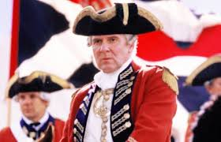
General Cornwallis
Britain's plan of attack was to have General Cornwallis move the war to the southern states to try to separate colonists in the South from Revolutionary forces in
the North
He immediately succeeded in a
series of British
victories, but the Americans were able to prevent a complete victory in the South.

Slide 10
Yorktown
Cornwallis pursued the Americans into Virginia but met with heavy resistance.
Wishing to maintain communications with Great Britain by sea, the British general retreated to the
coastal town of Yorktown
His forces were attacked by the combined French and American armies and a French fleet.
Cut off from any reinforcements, Cornwallis was forced to surrender
American Revolution came to an end in North America.

Slide 11
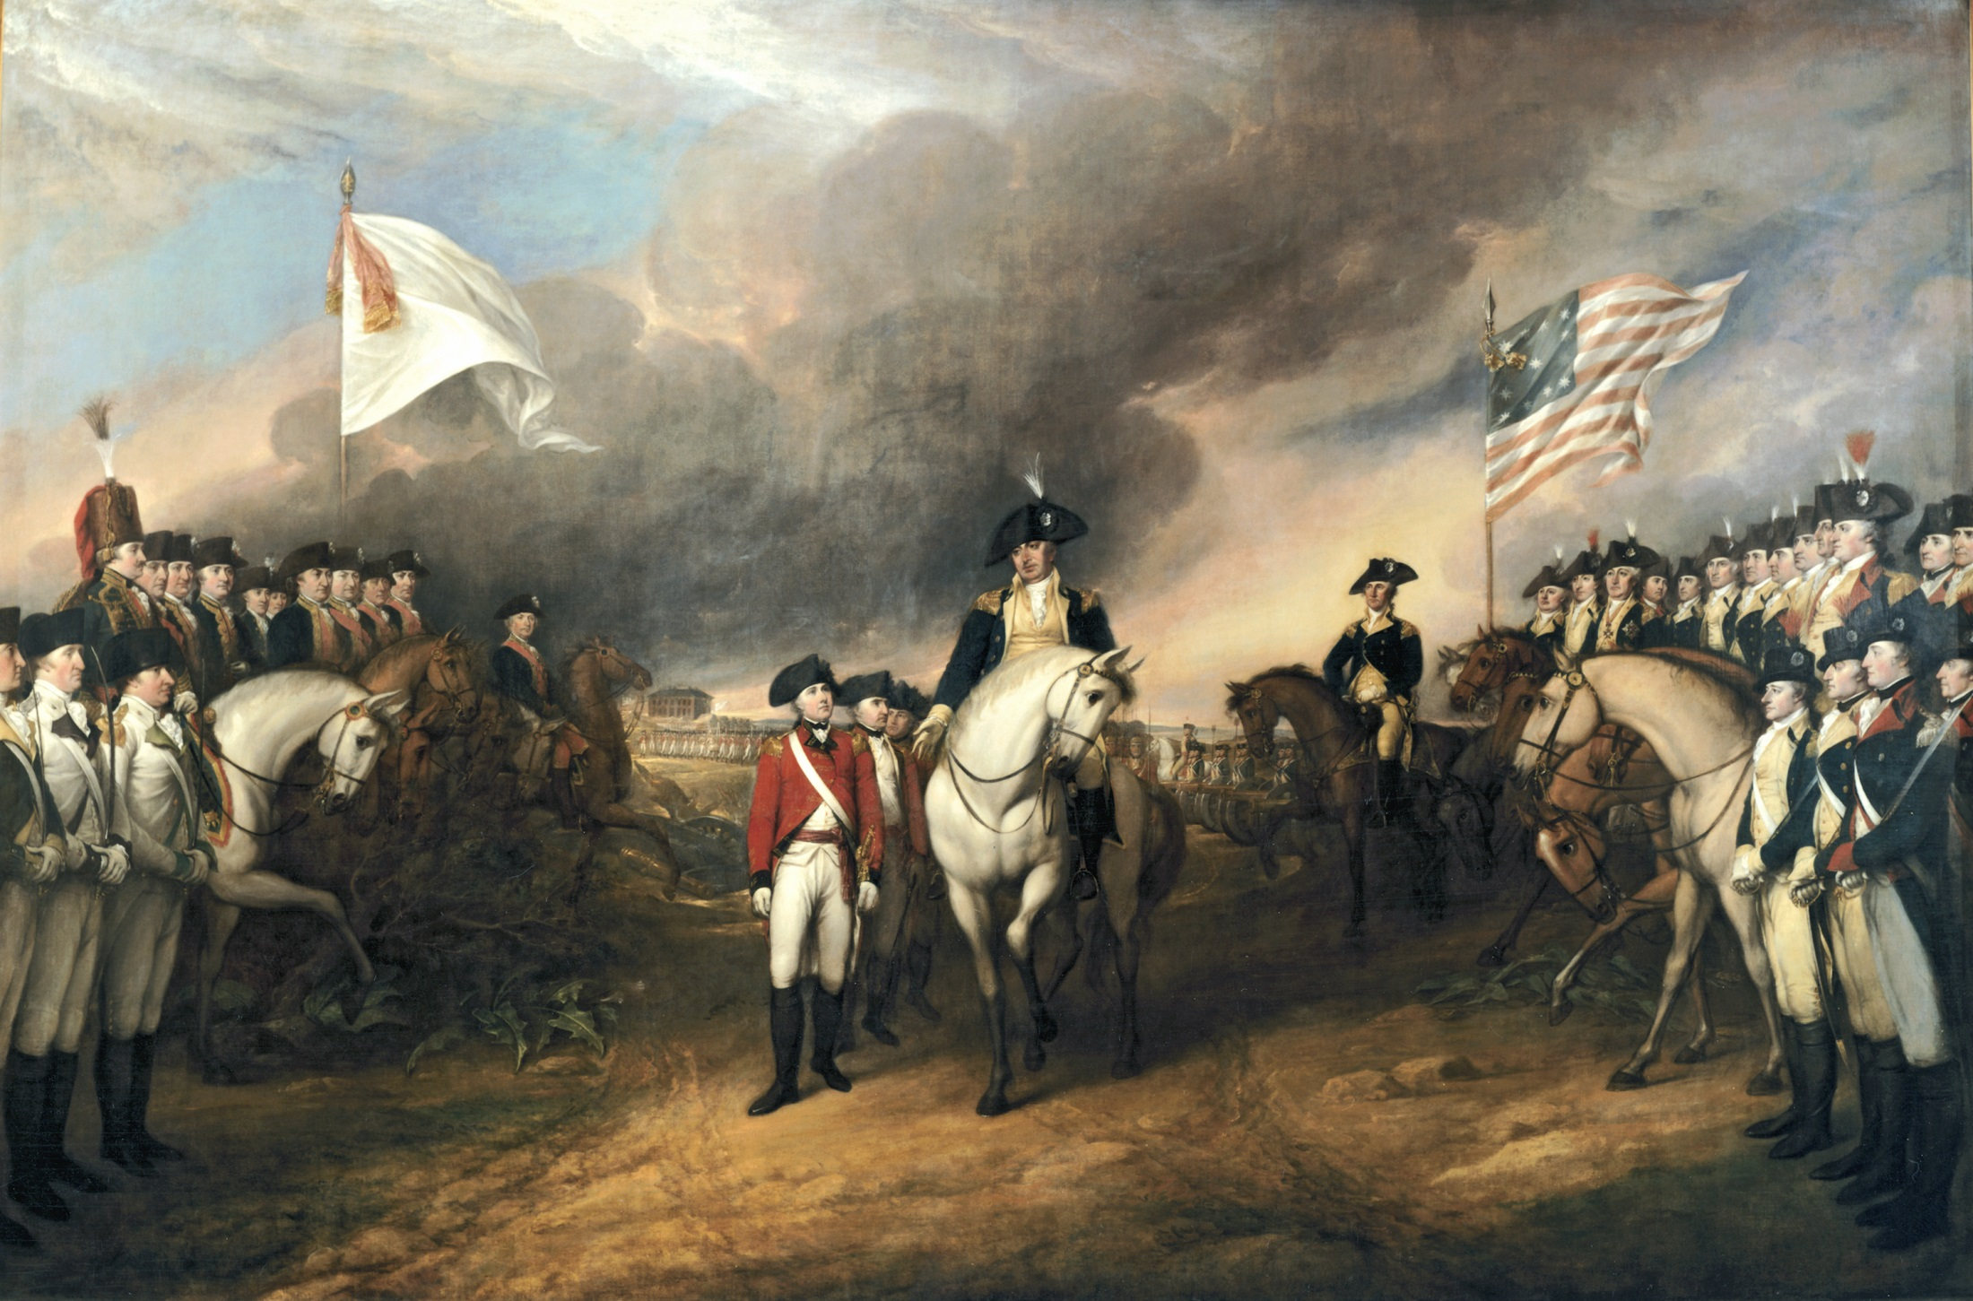

Slide 12
Treaty of Paris 1783
ended the Revolutionary War
The U.S. won the its independence & gained control of the land stretching to the Mississippi River
Britain ceded Florida to Spain and certain African and Caribbean colonies to France.

Slide 13
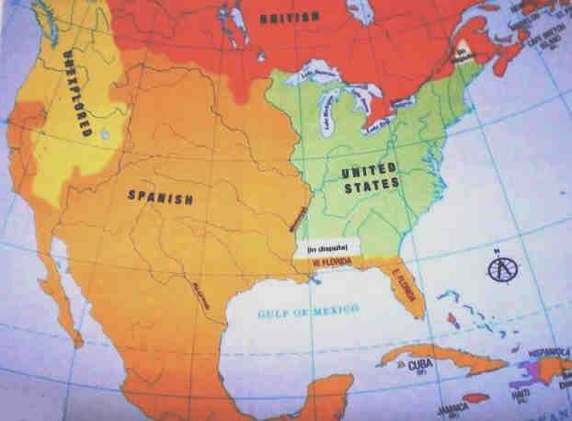

Slide 14
Activity: Staging the Revolution
You will be placed in groups
You will be given a piece of large paper & markers
Divide your paper into 3 parts
On your paper, you will be staging the two major battles of the American Revolution & the Continental Army’s camp:
Use the markers to draw out the battles/camp and use the army men show where these soldiers were.

Slide 15
Battle of Trenton (Crossing the Delaware) | Valley Forge
 | Battle of Yorktown

