Slide 1
Determinants of Demand
Create your own scenario

Slide 2
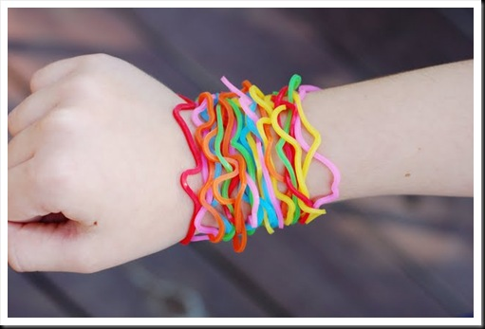
Consumer Tastes and Preferences

Slide 3
Consumer Tastes and Preferences
As goods and services become popular, the demand for that good increases.
Example – SillyBandz
SillyBandz became super popular and therefore the demand for the good increased. This caused the demand curve to shift to the right.

Slide 4
D1
Quantity

Slide 5
Success Criteria
Name of a good. Ex. Silly bandz​
List the determinant of demand​
Draw and explain the shift in the demand curve

