Slide 1
Why do people have to make choices?

Slide 2
Unit 1 Warm-Up #1
What decisions or choices have you had to make today, in the past, or in the future?
Do these choices have a “cost”?

Slide 3
EQ: Why do people have to make decisions?
Economics: the study of the choices people make to satisfy their needs and wants
Need: necessary for survival
Want: something we desire but is not essential
Examples?
Air, food, shelter

Slide 4
Needs and wants can be further classified as…
Goods: physical objects
Services: actions or activities that one person performs for another

Slide 5
Where do g/s come from?
Resources: anything that is used to make a g/s
Economists call these resources “Factors of Production”

Slide 6
Factors of Production
Land (natural resources)
Found in nature…oil, water, coal, trees
Labor (human resources)
Effort that a person devotes to a task
Capital (human-made resources used to make a g/s)
Physical Capital – buildings, tools, machinery
Human Capital – skills, education, etc.
Entrepreneurship – risk-takers who combine resources to create g/s

Slide 7
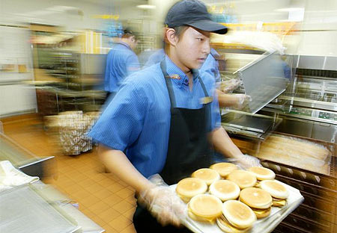
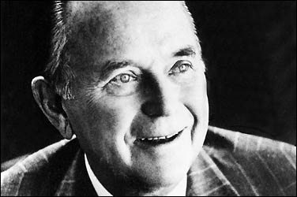
Labor
Land
Good
Capital
Entrepreneur

