Slide 1
Incentives, Marginal Benefit vs. Marginal Cost

Slide 2
Get ISS
Don’t skip
Get good grades

Slide 3
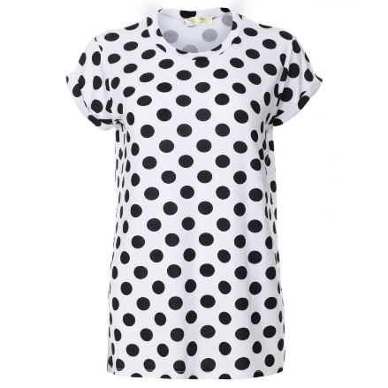
What is an incentive?
An expectation that encourages people to behave in a certain way.
(hope of reward or fear of punishment)
lower prices
Buy more
Polka dot shirts sell more than striped shirts,
Make more money
Company produces more polka dot shirts than striped shirts

Slide 4
What are some positive and negative incentives that have led to important choices in High School?
3 academic
3 work/community/extracurricular choices
3 savings/investing choices
3 family related choices

Slide 5
Thinking at the margin
When you decide how much more or less to do
Ex. Study 1 more hour, spend 1 more dollar

Slide 6
“Either–or” decisions
Tide or Cheer?
Buy a car or not?
An order of nachos or a sandwich?
Run your own business or work for someone else?
Prescribe drug A or drug B for your patients?
These are NOT marginal decisions!!!

Slide 7
“How much” decisions
How many days before you do your laundry?
How many miles do you go before an oil change in your car?
How many jalapenos on your nachos?
How many workers should you hire in your company?
How much should a patient take of a drug that generates side effects?
How many troops do you allocate to your invasion force?

Slide 8
Thinking at the Margin
Look at opportunity cost of each option and compare it to the benefit
This comparison is known as a “Cost-Benefit Analysis”
It is a good option when MC < MB (marginal cost is less than marginal benefit)

Slide 9
Options | Benefit | Opportunity Cost
1st hour of extra study time | Grade of “C” on test | 1 hour of sleep
2nd hour of extra study time | Grade of “B” | 2 hours of sleep
3rd hour of extra study time | Grade of “B+” on test | 3 hours of sleep

Slide 10
What should Karen decide?
At 3 hours the cost is no longer worth the benefit.
Karen lost another hour of sleep but only improved her grade slightly.

Slide 11
How many hours do you study?
Depends upon the benefit of studying each hour versus the cost
What do you give up each hour you study? Is it worth the benefit from studying?
Yes! Keep studying
No! Stop studying
Keep studying until Benefit = Cost

