Slide 1
Southern Colonies guided notes

Slide 2
Hashtag Activity
Video clip

Slide 3
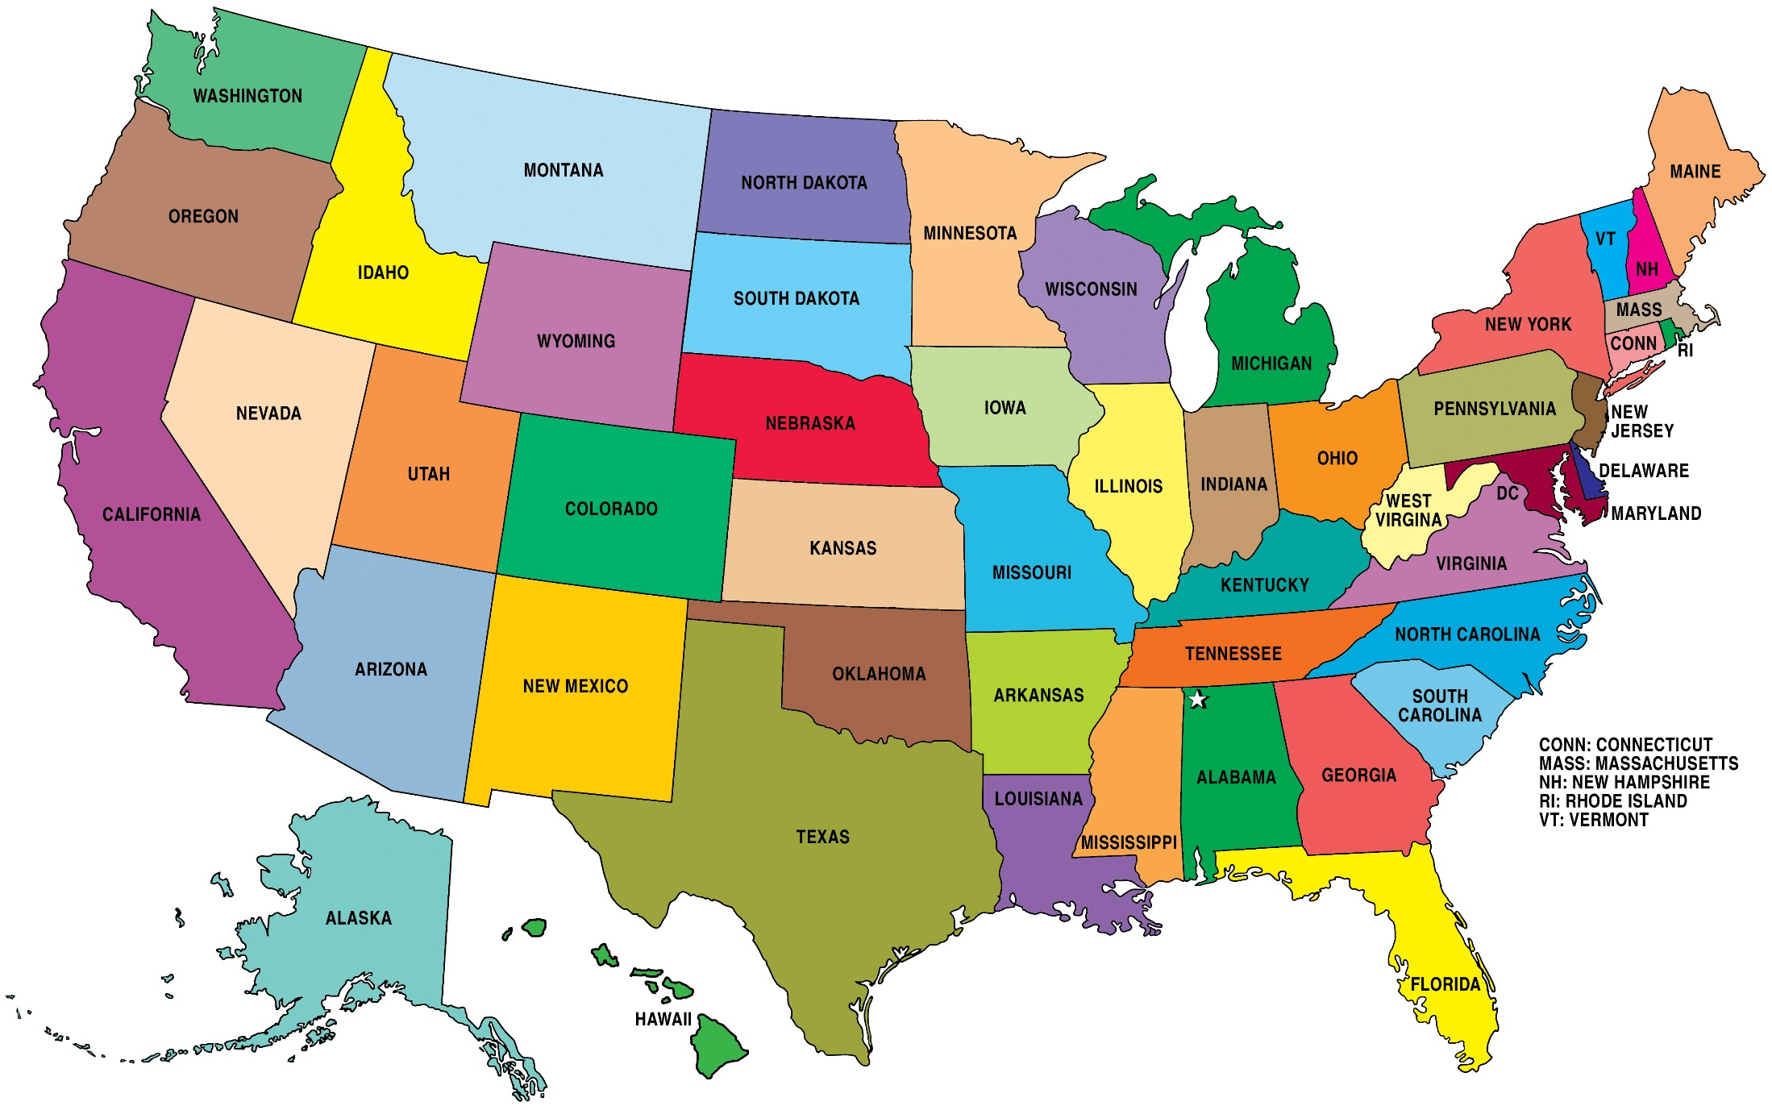

Slide 4
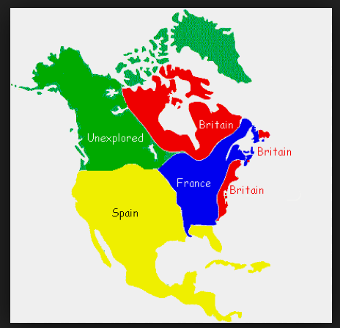
Quebec- fur trade
(France)

Slide 5
What is a colony?
Territories established by the government of a nation in a foreign land.

Slide 6
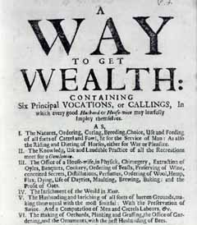

Slide 8
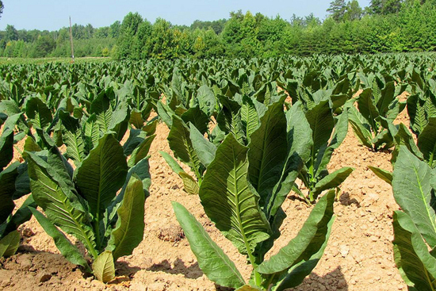

Slide 9
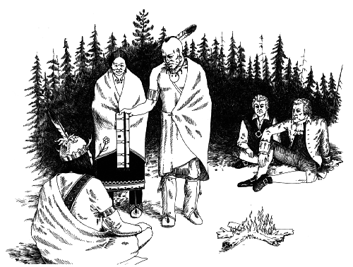

Slide 10
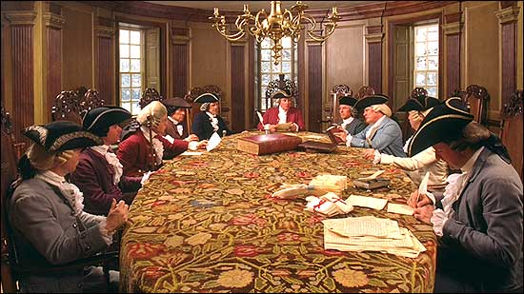

Slide 11
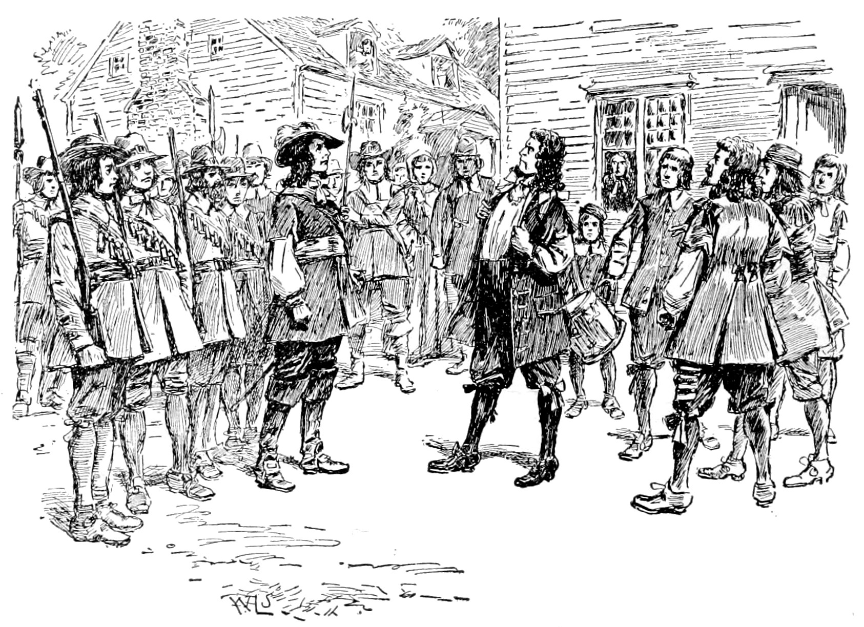

Slide 12
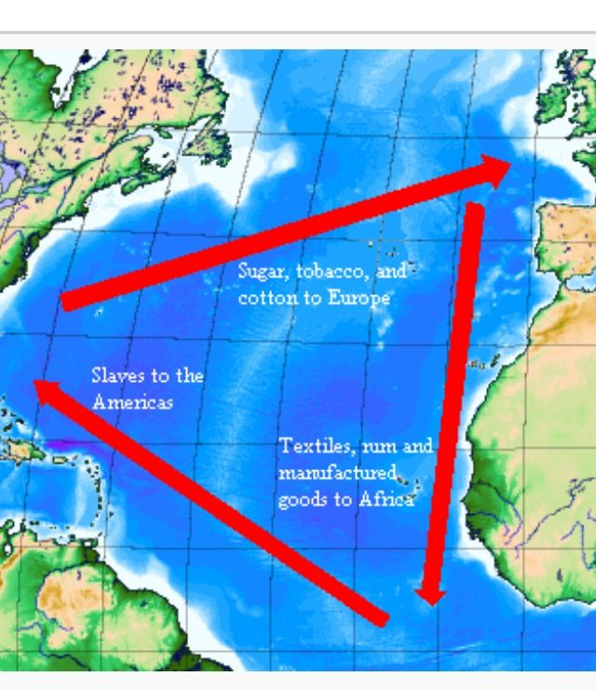

Slide 13
Would you ever leave your life for an unknown place?

Slide 14
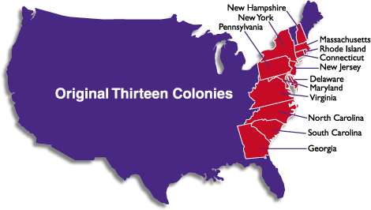

Slide 15
Before the development of Virginia
Who funded the first colonists’ trip to Virginia?
What country was responsible for maintaining the colonies?
Who was in Virginia before the colonists arrived?
What century did it all begin?

Slide 16
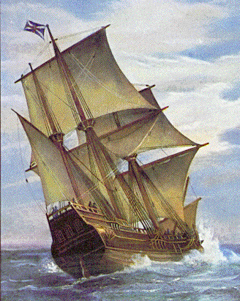
The Virginia Company
An English firm that planned to make money by sending people to America to find gold and other resources to send back home.

Slide 17
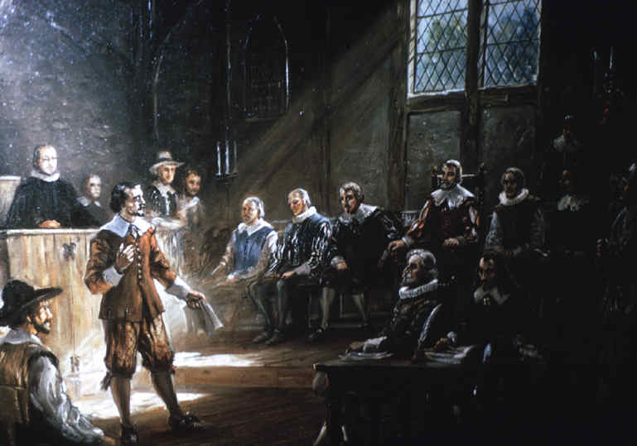
House of Burgesses
The first European type legislative body in the Colonies, established by the Virginia Company.
Representative
Government!

Slide 18
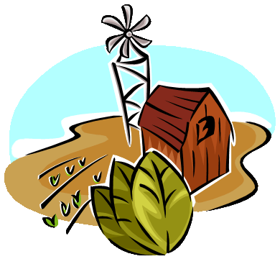
Tobacco
Tobacco became the major cash crop and source of wealth for the Virginia colony.

Slide 19
Tobacco
The work to cultivate tobacco was labor intensive, and led to the dependence on
slavery.

Slide 20
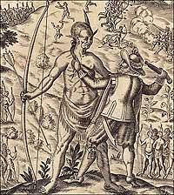
The Virginia colonists’ relations with the Powhatan Indian
The Powhatan Indians were indigenous to Virginia.
The colonists forced the Powhatans off their land to grow tobacco.

Slide 21
The Cause of Bacon’s Rebellion Conflict and Change!
Some Powhatans were still left after many were forced out.
The colonists who did not own land wanted the remaining Powhatans to be treated harsher (push them out too), so that more land would be available to the colonists.

Slide 22
Bacon’s Rebellion
The landless rebels staged a rebellion known as Bacon’s Rebellion- an uprising against the governor and his wealthy landowner supporters as an attempt to gain land ownership.

Slide 23
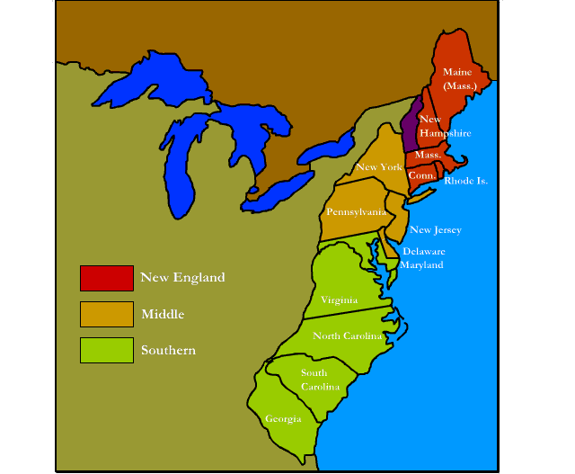

Slide 24
Jamestown

Slide 25
Virginia Company

Slide 26
Bacon’s Rebellion

Slide 27
tobacco

Slide 28
House of Burgesses

