Slide 1
Production Possibilities Curve

Slide 2
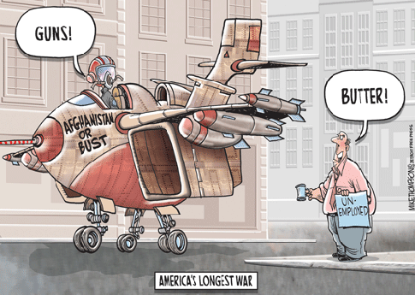
What is it?
A graphic representation of the different combinations of two products that can be made from a limited set of resources

Slide 3
PPC
Production Possibilities Curve: a graph that shows alternate ways to use an economy’s productive resources
Comparison between two g/s

Slide 4
Key Points on the Graph
Efficiency: using resources to maximize production
Points ALONG the PPC
Underutilization: using fewer resources than an economy is capable of using
Points INSIDE the PPC
Future PPC – impossible to reach with given resources and technology
Points OUTSIDE the PPC

Slide 5
Time Spent Per Product | Number of Pizzas | Number of Spaghetti Dinners
All on Pizzas | 100 | 0
¾ on Pizza ¼ on Spaghetti | 75 | 75
½ on Pizzas ½ on Spaghetti | 50 | 150
¼ on Pizza ¾ on Spaghetti | 25 | 225
All on Spaghetti | 0 | 300

Slide 6
Pizzas
100
75
50
25
0
300
75
150
Spaghetti
225

Slide 7
Pizzas
100
75
50
25
0
300
75
150
Spaghetti
225

Slide 8
Pizzas
100
75
50
25
0
300
75
150
Spaghetti
225

Slide 9
Pizzas
100
75
50
25
0
300
75
150
Spaghetti
225

Slide 10
Pizzas
100
75
50
25
0
300
75
150
Spaghetti
225

Slide 11
Pizzas
100
A
B
75
C
50
25
D
E
0
75
150
Spaghetti
225
300

Slide 12
Pizzas
100
A
B
75
C
50
25
F
D
E
0
75
150
Spaghetti
225
300

Slide 13
Pizzas
100
A
G
B
75
C
50
25
D
E
0
75
150
Spaghetti
225
300

